Slide 1

Draw Motion: Real-Time Hand Gesture Tracking and Interactive Drawing System
Birla Vishvakarma Mahavidyalaya
[ An Autonomous Institution ]
Information Technology Department
3IT31 – Mini Project
Presented By :
Akshay Gojiya (22IT452)
Shlok Goswami (22IT461)
Sai Mistry (22IT451)
Guide :
Dr. Nilesh B. Prajapati

Slide 2
Table of contents
01
Introduction
02
Modules
03
Requirements
04
Feasibility Study
05
Specific Requirements
06
Literature Review
07
System Features
08
System Features

Slide 3
DrawMotion
DrawMotion is a real-time hand gesture tracking and interactive drawing system that enables users to draw on a virtual canvas using finger movements. Unlike traditional methods that rely on external libraries like OpenCV or MediaPipe, this project is built entirely from scratch, using custom algorithms for hand detection, tracking, and gesture recognition.

Slide 4
Objectives and Scope
Objectives
Scope
Custom Hand Detection & Tracking
Real-Time Performance (Minimal lag)
Gesture-Based Drawing
No Third-Party Libraries
Scalable for AR/VR, Accessibility
Real-Time Gesture Tracking
Custom Algorithm Development
Compatible with various devices
Future Scalability (Multi-hand, AR/VR, etc.)

Slide 5

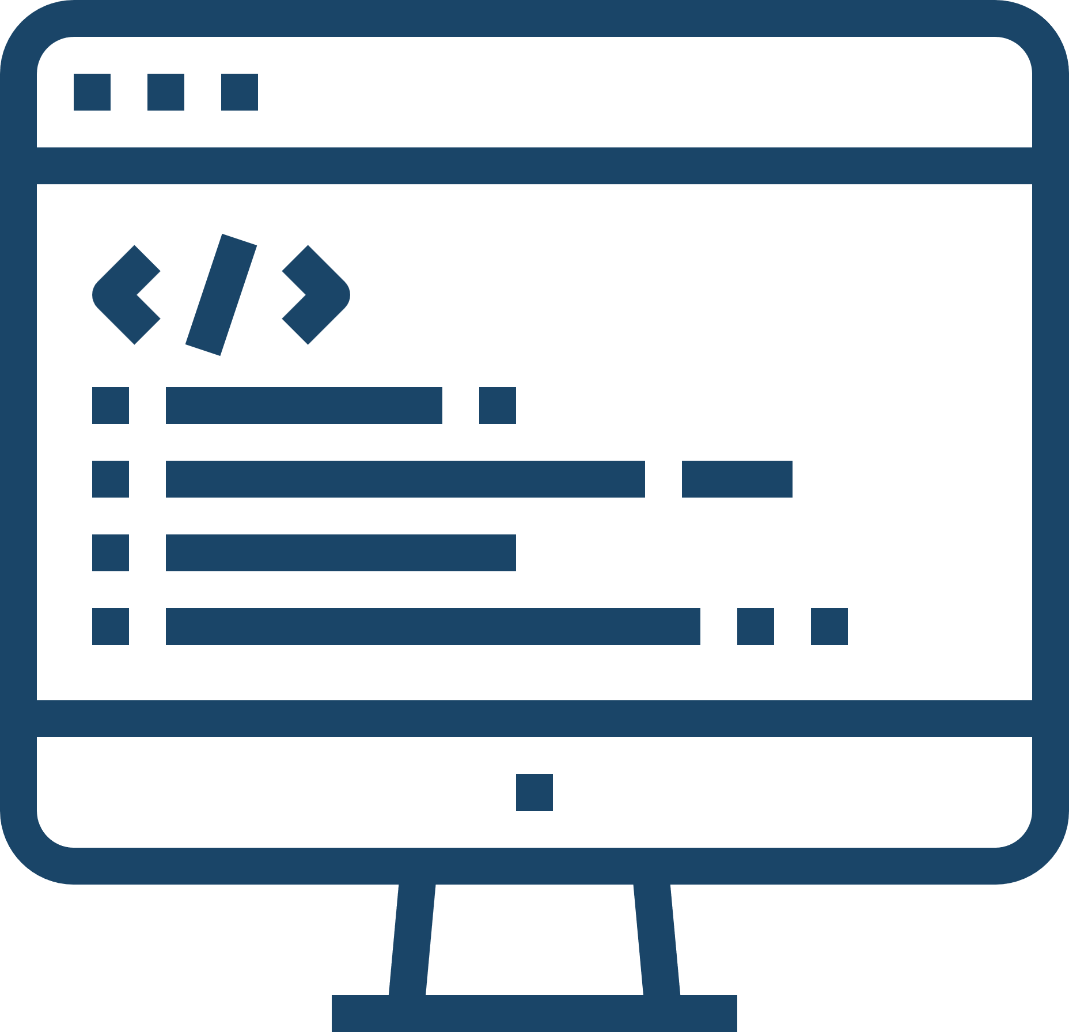
Requirements
Hardware
Software
HD Webcam, Intel i3+, 4GB RAM+
Python – Version 3.8 or higher (For Machine Learning & Gesture Processing)
JavaScript – ES6+ (For Frontend & Backend)
HTML5 & CSS3 – For Web UI

Slide 6
Modules
01
02
03
04
05
Video Capture
Hand Tracking
Drawing Module
Fetches live feed
Detects hand positions
Converts gestures into drawing
Gesture Recognition
UI & Event Handling
Identifies finger movements
Manages interactions

Slide 7
Feasibility Study
Technical Feasibility
Technology Availability, Accuracy and Reliability
Operational Feasibility
Ease of Use, User Training
Economic Feasibility
Development Cost, Maintenance Cost, Market Potential

Slide 8
PROJECT REQUIREMENT GATHERING
Techniques : Research and Literature Review, surveys, Prototyping.
Comparison :
Feature | MediaPipe/OpenCV-Based Systems | DrawMotion (CustomBuilt)
Dependency on Libraries | High | None
Algorithm Control | Limited | Full Control
Scalability | Medium | High
Customization of Features | Limited | Fully customizable

Slide 9
Literature review
Hand Gesture Recognition Using Deep Learning
Real-Time Hand Tracking and Gesture Recognition for Human-Computer Interaction
Interactive Drawing Systems Using Hand Gestures
Vision-Based Hand Gesture Recognition for Assistive Technologies
Gesture Recognition and Tracking for Real-Time Applications

